Slide 1
Beijing
Deep learning on graphs
George Karypis

Slide 2
Agenda
Overview of graph neural networks
Overview of DGL API
Hands-on tutorials of basic GNN applications
DGL on SageMaker

Slide 3
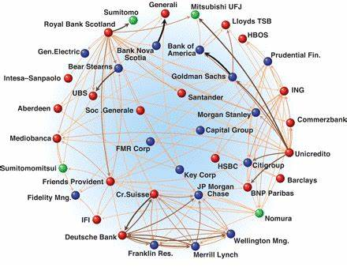
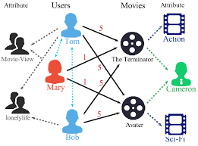
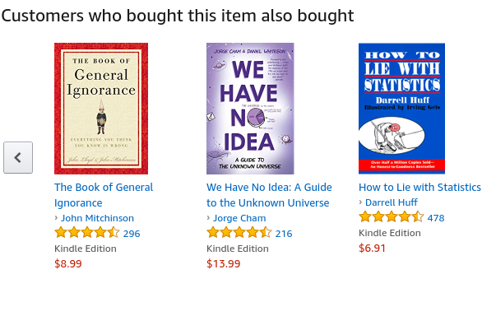
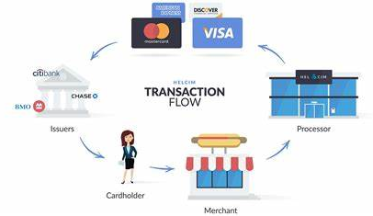
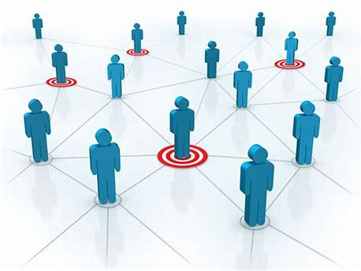
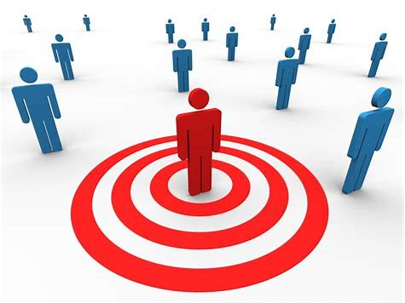
Fraud & Abuse
Recommendations
Detect malicious accounts, fraudulent financial transactions, fake reviews, fraudulent insurance claims, …
Products, media, articles, experiences, jobs, courses, spouses, …
Financial transactions network
Collaborative knowledge graph
Marketing
Who should get a discount? Who are the influencers? Who are the risk of churning?
Social network

Slide 4
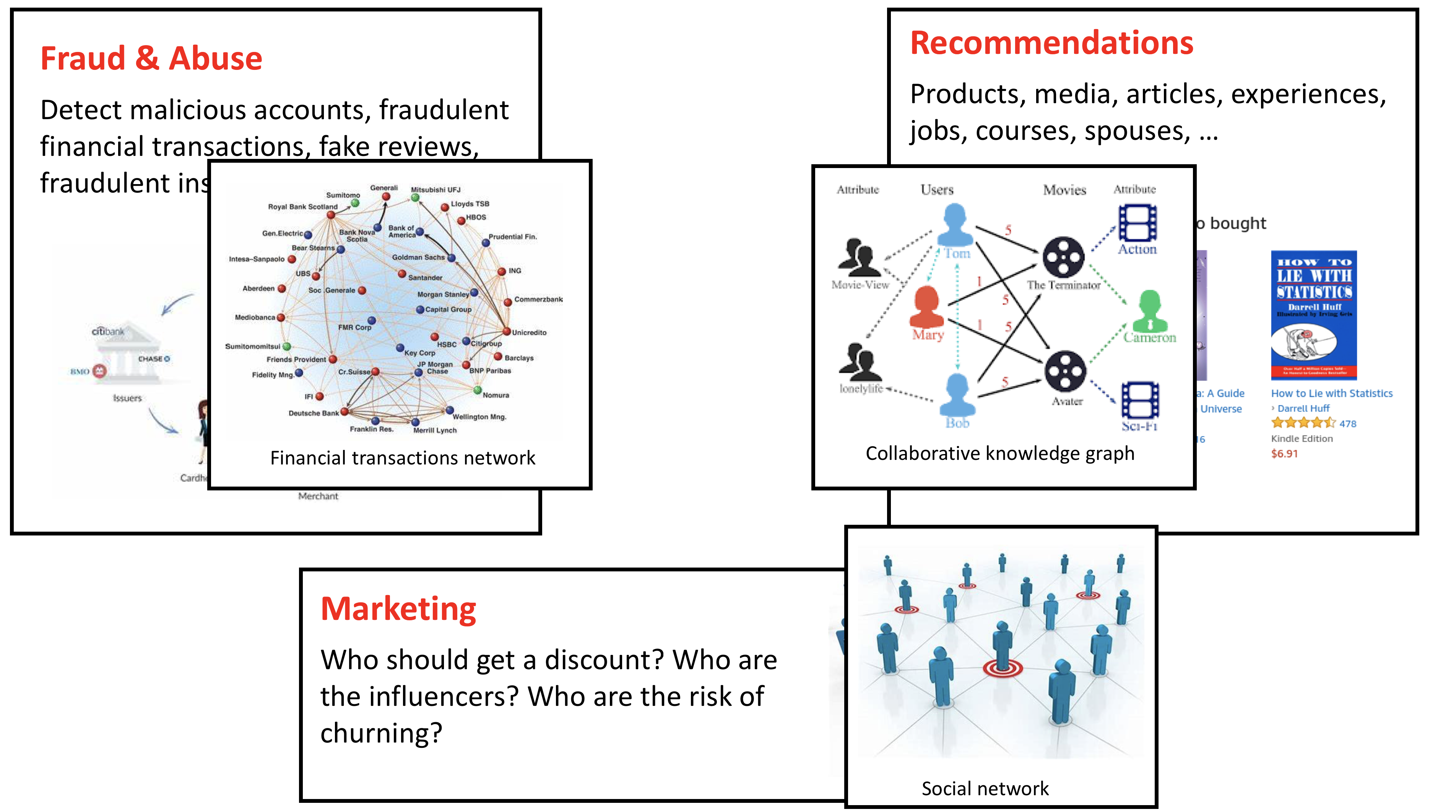
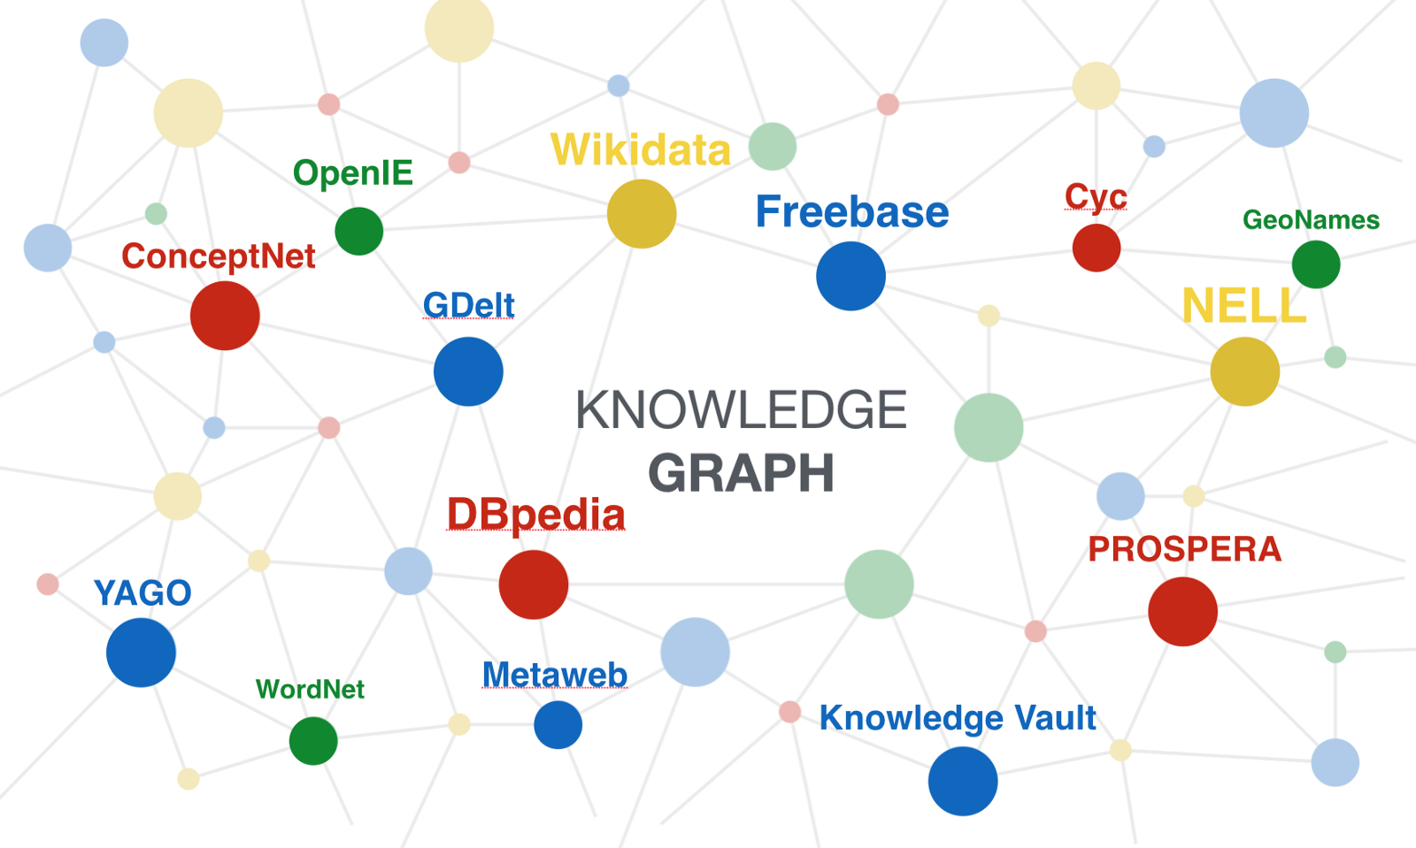
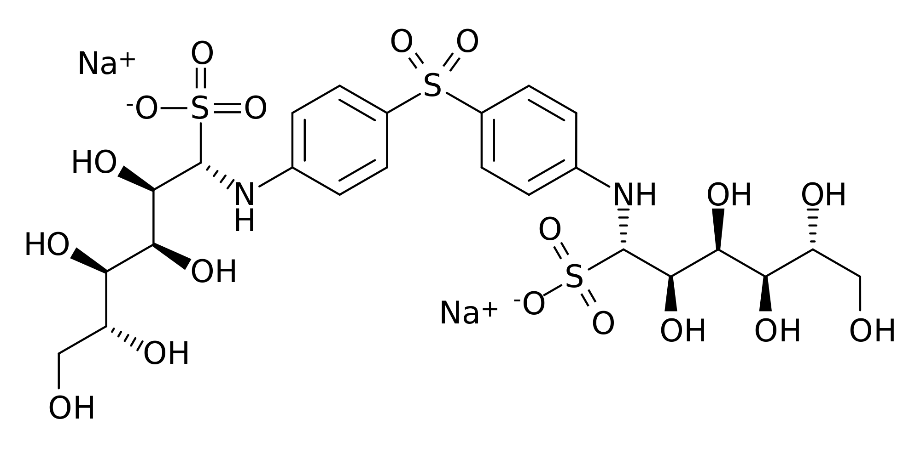
Tasks in graph learning
Node classification
Detect malicious accounts
Target right customers
Link prediction
Recommendations
Predict missing relations in a knowledge graph
Graph classification
Predict the property of a chemical compound
Drug discovery

Slide 5
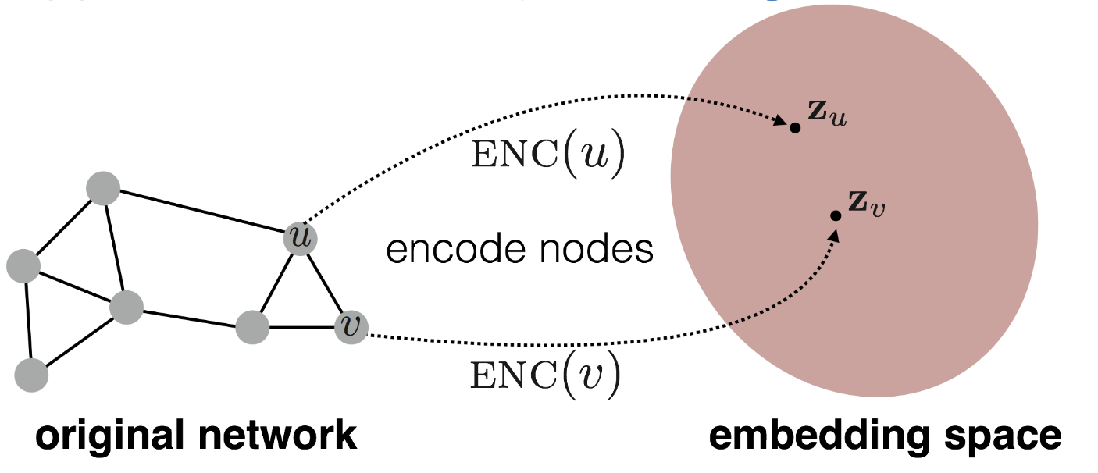
Graph learning requires to embed nodes
Embed nodes to a low-dimension space so that these embeddings capture the essential task-specific information and use them to train off-the-self classifiers.
For example, the similarity in the embedding space approximates similarity in the original graph.
Representation Learning on Networks, snap.stanford.edu/proj/embeddings-www, WWW 2018

Slide 6
Traditional solutions approaches
Generate embeddings by manual feature engineering
Requires domain expertise, involves considerable manual fine-tuning, time consuming, does not scale, …
Automatically generate embeddings using unsupervised dimensionality reduction approaches
Singular value decomposition, tensor decomposition, co-factorization, deep walks, etc.
Cannot effectively combine rich attributes with network structure.
Employ mostly (multi-)liner models.
Do not allow for end-to-end learning.
Drug discovery

Slide 7
What is GNN?
Graph Neural Network (GNN): learns embedding on nodes/edges/graphs
GNN
Classifier

Slide 8
What is new in GNN?
GNN computes node embeddings using both graph structure and node/edge features.
GNN are naturally inductive models because they run the same neural networks on nodes and edges.
GNN and downstream models can be trained in an end-to-end fashion.

Slide 9
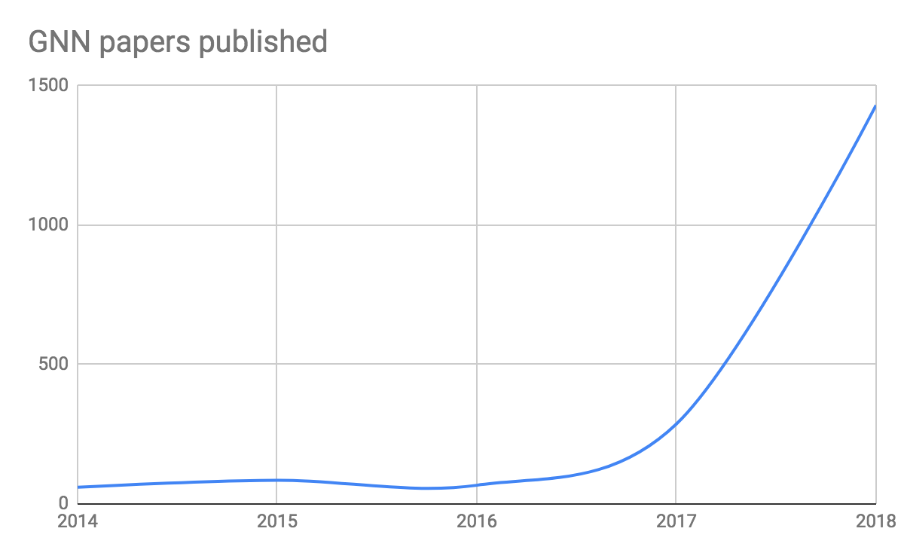
Deep learning + Graph
GNN is emerging as an important class of DL models.

Slide 10
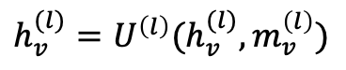
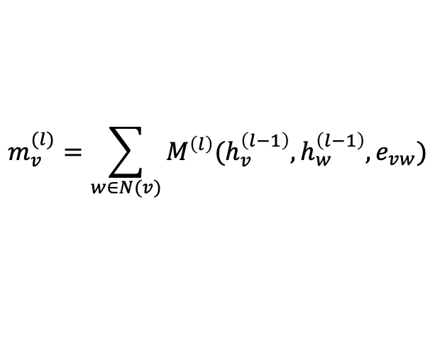
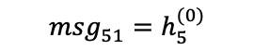
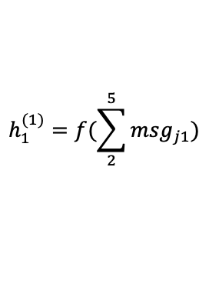
A general formalization of GNN
GNN is based on message passing
Reduce
Message
h₅
h₂
v₅
$$m_{v}^{(l)}=\sum_{w∈N(v)}{M^{\left(l\right)}(h_{v}^{\left(l−1\right)}, h_{w}^{\left(l−1\right)}, e_{vw})}$$
v₂
$${msg}_{51}^{}=h_{5}^{(0)}$$
v₁
$$h_{1}^{(1)}=f(\sum_{2}^{5}{{msg}_{j1}})$$
$$h_{v}^{(l)}=U^{\left(l\right)}(h_{v}^{(l)}, m_{v}^{\left(l\right)})$$
v₃
v₄
h₄
h₃
Neural Message Passing for Quantum Chemistry
Notes:
Message: tensor computed from source node/ destination node/ edge features
Reduce: aggregating the messages (and updating the node representation accordingly)

Slide 11
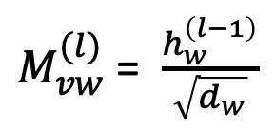
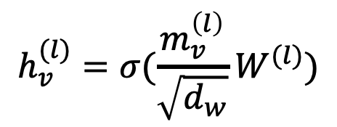
A GNN Example: Graph convolution network
$M_{vw}^{(l)}$= $\frac{h_{w}^{\left(l−1\right)}}{\sqrt{d_{w}}}$
$$h_{v}^{(l)}=σ(\frac{m_{v}^{\left(l\right)}}{\sqrt{d_{w}}}W^{(l)})$$

Slide 12
More explanation on GCN
Problems:
GCN aggregate all neighbors equally.
It cannot deal with heterogeneous graphs.

Slide 13
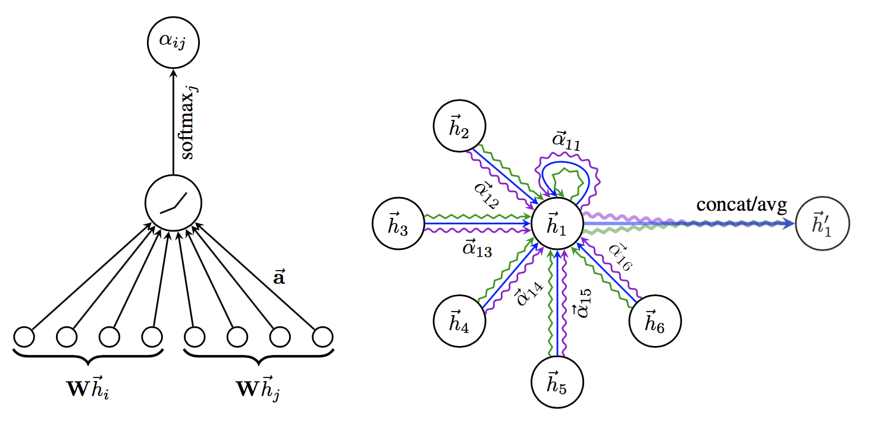
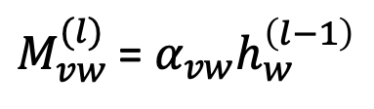
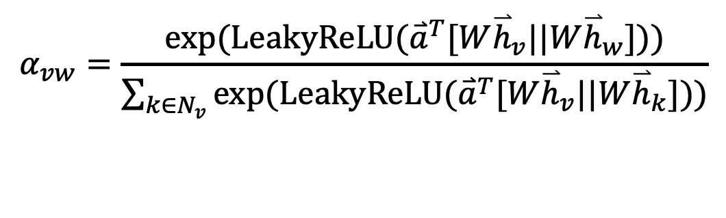
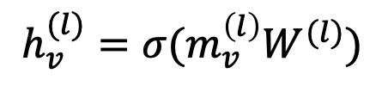
Example 2: Graph attention networks (GAT)
GAT provides weighted sum over the neighborhood.
$M_{vw}^{(l)}$= $α_{vw}h_{w}^{\left(l−1\right)}$
$$h_{v}^{(l)}=σ(m_{v}^{\left(l\right)}W^{(l)})$$
$$α_{vw}=\frac{exp⁡(LeakyReLU({\overset{⃑}{a}}^{T}[W{\overset{⃑}{h}}_{v}||W{\overset{⃑}{h}}_{w}]))}{\sum_{k∈N_{v}}{exp⁡(LeakyReLU({\overset{⃑}{a}}^{T}[W{\overset{⃑}{h}}_{v}||W{\overset{⃑}{h}}_{k}]))}}$$

Slide 14
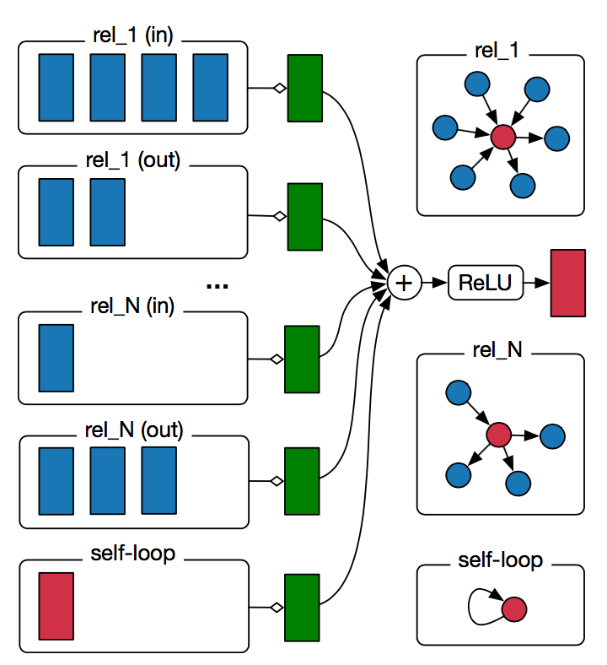
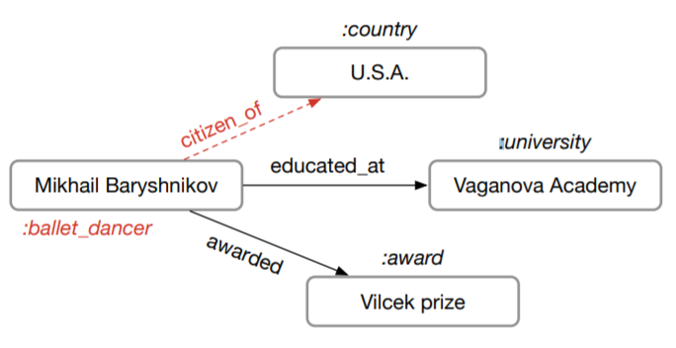
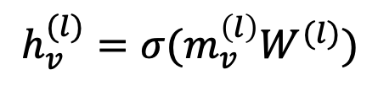
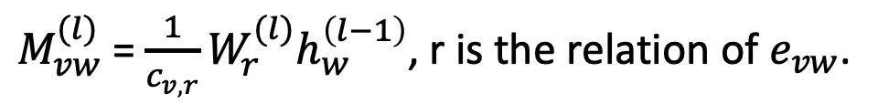
Example 3: Relational graph convolution networks (RGCN)
Handle graphs whose nodes are connected with different relations.
$M_{vw}^{(l)}$= $\frac{1}{c_{v,r}}W_{r}^{(l)}h_{w}^{\left(l−1\right)}$, r is the relation of $e_{vw}$.
$$h_{v}^{(l)}=σ(m_{v}^{\left(l\right)}W^{(l)})$$

Slide 15
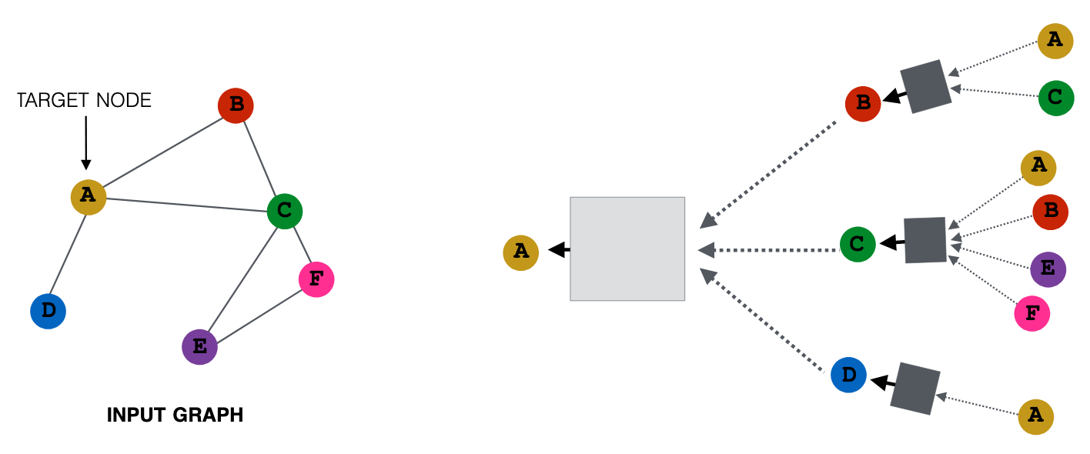
A multi-layer GNN
Multiple GNN layers can be stacked together.
Representation Learning on Networks, snap.stanford.edu/proj/embeddings-www, WWW 2018

Slide 16
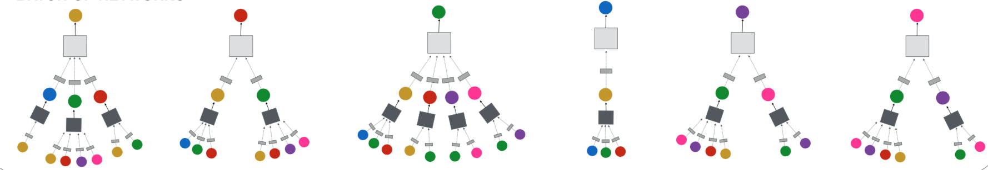
The power of GNN
GNN computes a node embedding based on the node and its local neighborhood.

Slide 17
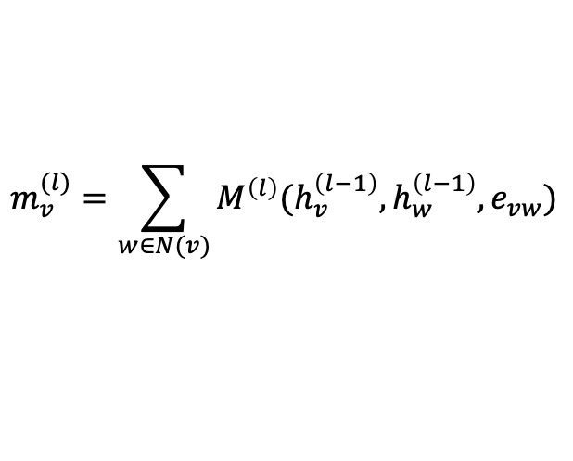
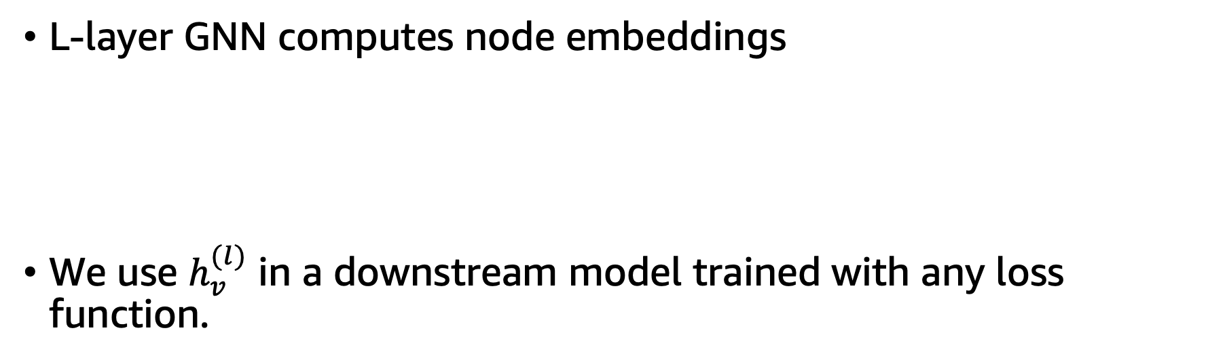
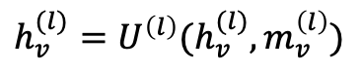
How to train a GNN?
L-layer GNN computes node embeddings
We use $h_{v}^{(l)}$ in a downstream model trained with any loss function.
$$m_{v}^{(l)}=\sum_{w∈N(v)}{M^{\left(l\right)}(h_{v}^{\left(l−1\right)}, h_{w}^{\left(l−1\right)}, e_{vw})}$$
$$h_{v}^{(l)}=U^{\left(l\right)}(h_{v}^{(l)}, m_{v}^{\left(l\right)})$$

Slide 18
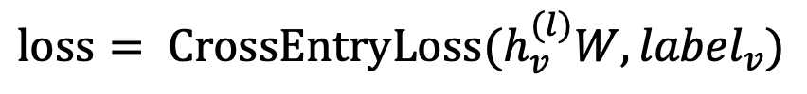
Node classification with GNN
Node classification is trained in the semi-supervised setting.
$$loss= {CrossEntryLoss(h}_{v}^{(l)}W, {label}_{v})$$
0
1
0
?
?
?

Slide 19
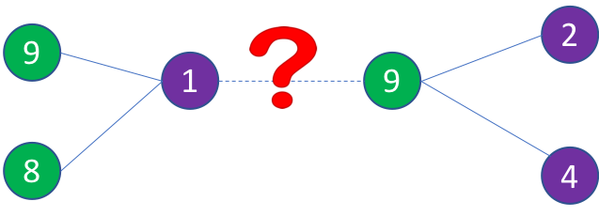
Link prediction with GNN
We can train a link prediction model with connectivity of nodes as the training signal.
Positive edges are trained against a few negative edges
${loss= −log (σ⁡(h}_{v}^{T}h_{w}))−Q∙E_{u_{n}\sim P_{n}(v)}{log (σ⁡(−h}_{v}^{T}h_{u_{n}})$)
Positive edges
Negative edges
Graph convolution to
encode node embeddings
Graph convolution to
encode node embeddings

Slide 20
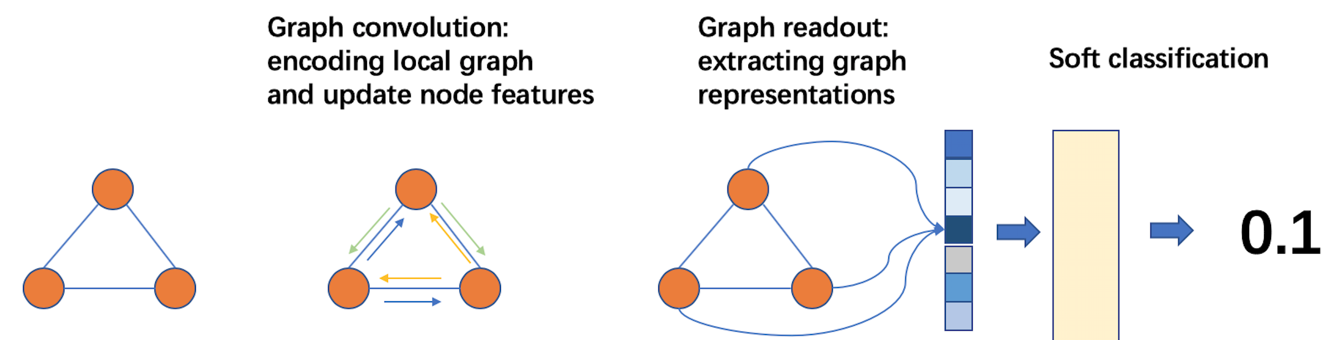
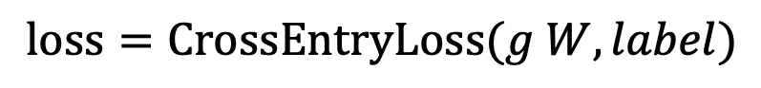
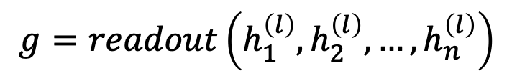
Graph classification
Graph readout to compute graph embeddings
Train a graph classifier on the graph embedding.
$$g=readout\left(h_{1}^{\left(l\right)},h_{2}^{\left(l\right)}, …,h_{n}^{\left(l\right)}\right)$$
$$loss=CrossEntryLoss(g W, label)$$

Slide 21
How to train GNN on large graphs
Many giant graphs at billion scale:
Social networks
Recommendation
Knowledge graph
…
A typical training method: mini-batch training

Slide 22
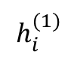
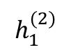
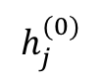
A glance of mini-batch training on graphs
A mini batch represents the computation graph for target nodes.
Small-world graphs lead to a huge computation graph.
2
3
$$h_{1}^{(2)}$$
1
1
10
5
$$h_{i}^{(1)}$$
2
3
4
5
6
9
4
6
8
7
$$h_{j}^{(0)}$$
1
3
4
6
7
8
9
10
11
11

Slide 23
Mini-batch with neighbor sampling
Prune the computation graph:
sample neighbors from a neighbor list of a vertex.
1
1
2
3
4
5
6
2
4
1
7
8
1
3
4
6
7
8
9
10
11

Slide 24
Summary
Many applications can be formulated as graph problems.
Graph neural network is a new technique for graph learning.
GNN has multiple advantages over traditional methods.
We demonstrate how GNNs are used in multiple graph tasks and how these GNN models can be trained.

Slide 25
Thank you!
DGL website: http://dgl.ai
DGL doc: http://doc.dgl.ai

Slide 26
Notebook setup
Please send an email to dgl-devday@request-nb.mxnet.io
You’ll get two replies in a few minutes. The second email contains a URL of the SageMaker notebook instance.

Slide 27
Backup slides

Slide 28
Recommendations
Fraud & Abuse
Products, media, articles, experiences, jobs, courses, spouses, …
Detect malicious accounts, fraudulent financial transactions, fake reviews, fraudulent insurance claims, …
Marketing
Who should get a discount? Who are the influencers? Who are the risk of churning?

Slide 29
A graph view of the business problems
Social network
Financial transactions network
Collaborative knowledge graph

Slide 30
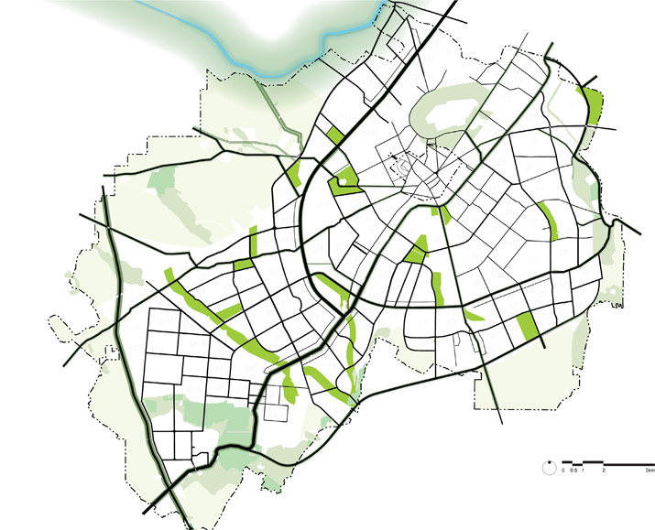
More graph problems
Drug discovery
Knowledge graph
Road network

Slide 31
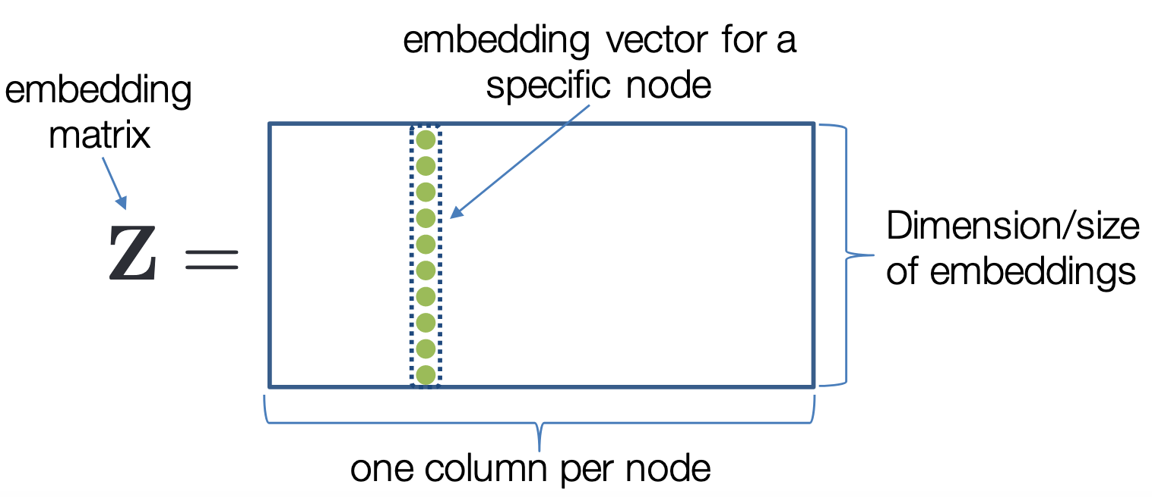
Traditional methods for network embedding
Network embeddings
Matrix factorization
Tensor decomposition
Deep Walk
Autoencoder
…
Traditional methods use embedding matrix to encode.
Representation Learning on Networks, snap.stanford.edu/proj/embeddings-www, WWW 2018

Slide 32
Limitations in traditional methods
Problems:
Traditional methods are all transductive.
Only learn from the graph structure.
Network embeddings cannot be trained with the supervision from the downstream tasks.

Slide 33
Graph learning requires to embed nodes
Embed nodes to low-dimension space so that similarity in the embedding space approximates similarity in the original graph.
Representation Learning on Networks, snap.stanford.edu/proj/embeddings-www, WWW 2018

